Slide 1


Development of Advanced Traffic Monitoring System using CNN based YOLOv8 Deep Learning Modal
This presentation explores the development of an advanced traffic monitoring system using CNN-based YOLOv8 deep learning. The system aims to detect and classify real-time moving objects in video footage, providing valuable insights for traffic flow analysis and pollution control.
by Ayush Kumar Singh

Slide 2
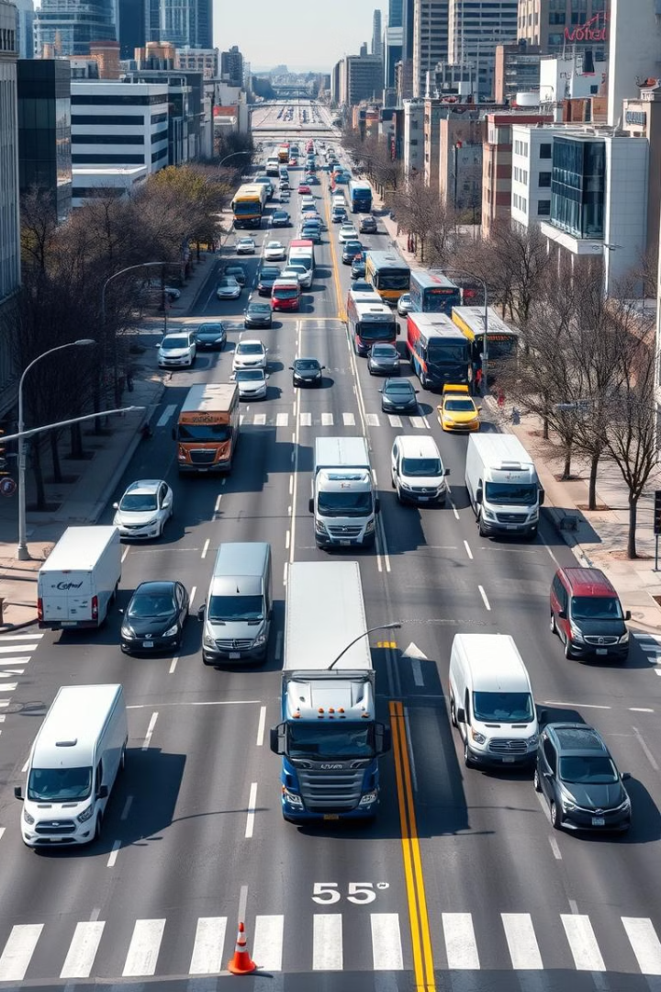
Objective
1
Object Detection
2
Object Classification
Identify and locate moving objects in video footage.
Categorize detected objects, such as cars, trucks, and buses.
3
Object ID Management
4
Accuracy and Counting
Track and manage individual objects for accurate counting and analysis.
Ensure high accuracy in object detection and classification for reliable traffic flow analysis.

Slide 3
Introduction
Object Detection and Classification
Reasons for Choosing YOLOv8
Applications
The system has applications in pollution control and estimation, as well as traffic flow analysis.
The system utilizes deep learning algorithms to detect and classify moving objects in real-time.
YOLOv8 is a powerful and efficient deep learning model known for its accuracy and speed in object detection.

Slide 4
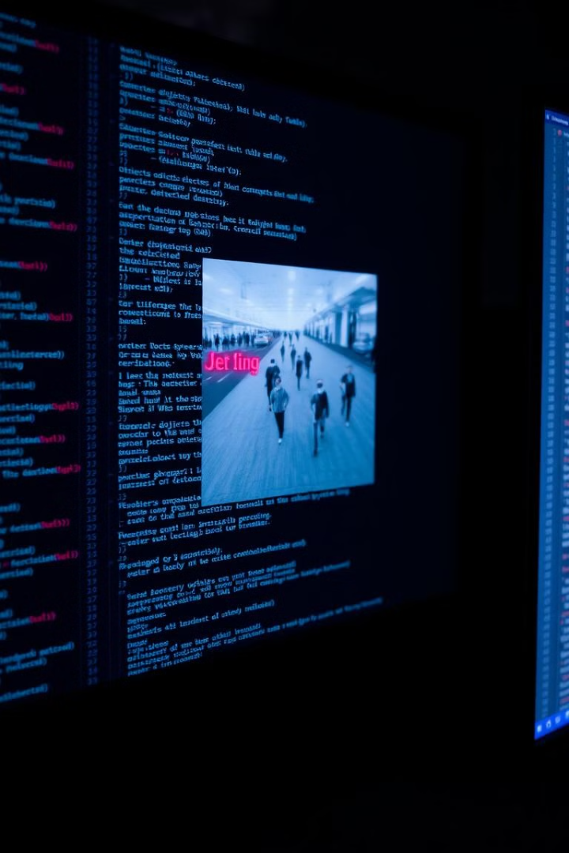
First Model Using Opencv
OpenCV Implementation
Challenges Encountered
An initial attempt was made using OpenCV for object detection.
The model faced several errors due to the lack of thresholding and proper image processing techniques.

Slide 5




Improvisations Using Opencv
Background Subtraction
Thresholding
Contour Detection
Implemented background subtraction using BgSub to isolate moving objects.
Applied thresholding techniques to enhance object boundaries and improve detection accuracy.
Utilized contour detection to identify and track moving objects.

Slide 6

Using ML, How Can We Improve?
1
Supervised Machine Learning
The system leverages supervised machine learning for object detection.
2
YOLOv8 Model
YOLOv8 is a pre-trained object detection model that excels in real-time applications.
3
Training on Labeled Images
The model is trained on a dataset of labeled images to learn object features and patterns.

Slide 7

Dataset Creation Process
1
Collect Images
2
Annotate
3
Extract Data
4
Train Model

Slide 8
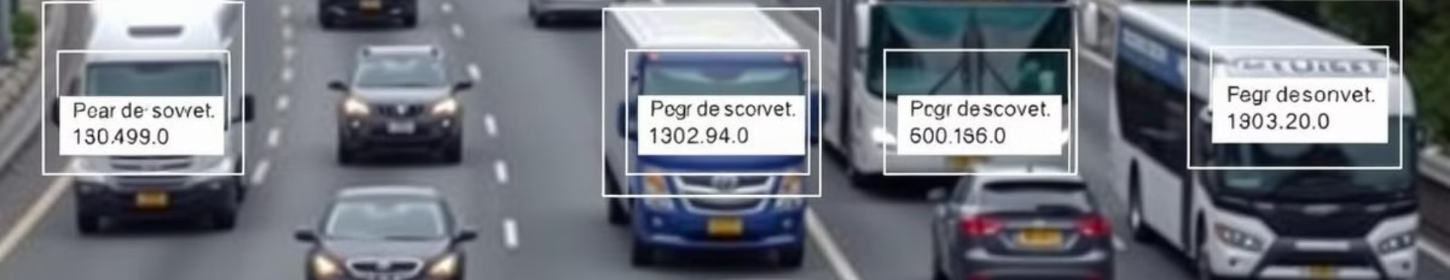



Results
Vehicle Tracking
Accuracy
Data Analysis
The system tracks the count of different vehicle categories.
The system achieves high accuracy in object detection and classification.
The system provides valuable data for traffic flow analysis and pollution control.

